Slide 1
BANK PERSONAL LOAN PREDICTION
S.SHIVA SURYA PRAKASH
PGA – 20
IMARTICUS (BANGALORE – KORAMANGALA)

Slide 2
PROBLEM STATEMENT
Predicting whether the customer get personal loan or not ,by using some of relevant features

Slide 3
DATA DESCRIPTION
The file Bank.xls contains data on 5000 customers. The data include customer demographic information (age, income, etc.), the customer's relationship with the bank (mortgage, securities account, etc.), and the customer response to the last personal loan campaign (Personal Loan). Among these 5000 customers, only 480 (= 9.6%) accepted the personal loan that was offered to them in the earlier campaign

Slide 4
ATTRIBUTE INFORMATION
1.ID : Customer ID
2.Age : Customer's age in completed years
3.Experience : #years of professional experience
4.Income : Annual income of the customer ($000)
5.ZIP Code : Home Address ZIP code.
6.Family : Family size of the customer
7.CCAvg : Avg. spending on credit cards per month ($000)
8.Education : Education Level. 1: Undergrad; 2: Graduate; 3: Advanced/Professional
9.Mortgage : Value of house mortgage if any. ($000)
10.Personal Loan : Did this customer accept the personal loan offered in the last campaign?
11.Securities Account : Does the customer have a securities account with the bank?
12.CD Account : Does the customer have a certificate of deposit (CD) account with the bank?
13.Online : Does the customer use internet banking facilities?
14.Credit card : Does the customer use a credit card issued by

Slide 5
PROCEDURE
EXPLORATORY DATA ANALYSIS
MODEL BUILDING
BASIC DATA CHECK

Slide 6
BASIC DATA CHECK
Understanding the dataset
Describing the Categorical variable
Describing the Numerical Variable
Checking the dataset is balanced or imbalanced
Check the data types of variables
Checking the value counts of the dataset
Checking the shape of the data(Rows and Columns)

Slide 7
EXPLORATORY DATA ANALYSIS
Checking for the missing values
Checking for the outliers
Analyzing the categorical and numerical data by plotting the graph
Univariate Analysis
Bivariate Analysis
Multivariate Analysis

Slide 8
MODEL BUILDING
Separating the features(independent) from the dataset
Separating the target (dependent) from the dataset
Splitting the dataset into the train and test from the feature variable
Building Logistic Regression
Building the Random Forest Classifier
Building the Decision Tree Classifier
Building the Gradinet boosting Classifier
Building the Adaboosting Classifier
Building the Xgboost Classifier
Building the Naïve Bayes
Building the SVM Classifier
Building the KNN classifier

Slide 9
STEPS
Dropping the ID column from the dataset ,ID does not help us to predicting the value
To Check the class is imbalanced or balanced. We need to count the number of 0's and 1's in the target(Personal Loan). So the count plot is used to visualize the target(Personal Loan)
The target(Personal Loan) datapoint class is imbalanced ,It contains the 90.4% percent of 0 and 9.6% of percent of 1.
To make the class balanced ,we must make some of the duplicate rows which Personal Loan is 1 ,to make the data balanced
The missing value is numerical . So we are using the KNN imputer to fill the missing value
Plotting the Univariate ,Bivariate and Multivariate for understanding the data

Slide 10
STEPS
Removing the outliers for the data of ("Income“ ,"ZIP Code“ ,"CCAvg“ ,"Mortgage" ) by using the IQR method
Separating the dependent and independent variable. The scaling and dummies are only created on the independent variable
Normalization is done for the numerical variable(to normalize the data)
OneHotEncoding(Dummie Variable creation) is done for the categorical data(this is done because the computer(or) machine understand only zeros and ones)
Concating the both Normalized(numerical) data and dummies data(categorical)
Splitting the raw data into the train and test

Slide 11
STEPS
Train data contains the 80% of the raw data and the Test data contains the remaining 20% of the data
In the train and test we are splitting the both independent as X and dependent variable as Y
Checking for Variance inflation Factor(VIF) provides a measure of multicollinearity(data with same information) among the independent variables
Checking for the P_value .If P_value is greater than 0.05 ,it means there is no connection between the target and the specific independent variable
So Dropping the specific independent variable > 0.05, which has no impact on making the model
By deleting the some of the irrelevant columns by using VIF and Pvalue, we can get the better accuracy

Slide 12
Logistic Regression Model
Building the Logistic Regression Model, Logistic Regression which is used for the Classification Problems, it is a predictive analysis algorithm and based on the concept of probability
By using the model we can predict, Whether its getting Loan or not
We are Checking the how many 0’s are predicting as 0’s, 1’s are predicting as 1’s,0’s are predicting as 1’s and 1’s are predicting as 0’s by using the Confusion matrix
Predicting the 0’s as 0’s and 1’s as 1’s increase the accuracy of the model
Predicting 1’s as 0’s and 0’s as 1’s decrease the accuracy of the model

Slide 13
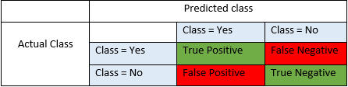
Logistic Regression
Classification Report consists of F1score,Precision,Recall,Average,Micro Average and Macro Average
Precision: TP/(TP+FP) # (TP/Total Predicted Positives)
Recall: TP/(TP+FN) # (TP/Total Actual Positives). Also known as 'TPR' or 'Sensitivity‘
F1 Score: 2* Precision * Recall/(Precision + Recall)
Precision, Recall, F1 Score interpretation: All have bounds between 0 & 1. Higher the value, better the model
Accuracy of the model is 90 percent

Slide 14
DECISION TREE CLASSIFIER
Building the Decision Tree Classifier(A decision tree is a graphical representation of all possible solutions to a decision based on certain conditions. On each step or node of a decision tree, used for classification, we try to form a condition on the features to separate all the labels or classes contained in the dataset to the fullest purity.)
We are predicting the target by using the Decision Tree Classifier
We are doing the confusion matrix for checking the TP,FP,TN and FN
By Classification report ,we get the F1score,precision,recall and Accuracy
Accuracy of the model(before hyperparameter tuning) is 99.1 percent

Slide 15
DECISION TREE CLASSIFIER (HYPERPARAMETER TUNING)
HyperParameter tuning of the Decision Tree Classifier(To find the best tuning parameter of the Decision Tree Classifier .we are doing gridsearchcv)
Tuning Parameter are criterion,max_depth and min_samples_leaf
We are taking best parameter .which gives the better the accuracy
DecisionTreeClassifier(criterion = "entropy",max_depth = 10,max_features = 9,min_samples_leaf = 2,random_state =123)
Accuracy of the model(after hyperparameter tuning)is 98.6 percent

Slide 16
RANDOM FOREST CLASSIFIER
Building the Random Forest Classifier (The random forest is a classification algorithm consisting of many decisions trees. It uses bagging and feature randomness when building each individual tree to try to create an uncorrelated forest of trees whose prediction by committee is more accurate than that of any individual tree.)
We are predicting the target by using the Random Forest Classifier
We are doing the confusion matrix for checking the TP,FP,TN and FN
By Classification report ,we get the F1score,precision,recall and Accuarcy
The Accuracy of random forest model(before Hyper parameter tuning) is 99.2 percent

Slide 17
RANDOM FOREST CLASSIFIER (HYPERPARAMETER TUNING)
HyperParameter tuning of the Random Forest Classifier(To find the best tuning parameter of the Random Forest Classifier .we are doing gridsearchcv)
Tuning Parameter are n_estimator(total no of trees) and min_sample_leaf (sample leaf split)
We are taking best parameter .which gives the better the accuracy
RandomForestClassifier(criterion = "entropy",max_depth = 10,max_features = 7,min_samples_leaf =2,n_estimators =100, random_state=123)
The Accuracy of the model(after hyperparameter tuning) is 98.8 percent

Slide 18
BOOSTING
Boosting is a general ensemble method that creates a strong classifier from a number of weak classifiers
This is done by building a model from the training data, then creating a second model that attempts to correct the errors from the first model. Models are added until the training set is predicted perfectly or a maximum number of models are added.
We are doing different type of boosting methods:
1.Adaboosting classifier
2.Xgboosting Classifier
3.Gradient Boosting Classifier

Slide 19
GRADIENT BOOSTING CLASSIFIER
Building a gradient Boosting classifier
We are predicting the target by using the Gradient boosting classifier
We are doing the confusion matrix for checking the TP,FP,TN and FN
By Classification report ,we get the F1score,precision,recall and Average
The Accuracy of the gradient boosting classifier is
98.0 percent

Slide 20
ADABOOSTING CLASSIFIER
Building a Ada Boosting classifier
We are predicting the target by using the Ada boosting classifier
We are doing the confusion matrix for checking the TP,FP,TN and FN
By Classification report ,we get the F1score,precision,recall and Average
The Accuracy of the AdaBoosting classifier is
93.5 percent

Slide 21
XGBOOSTING CLASSIFIER
Building a XG Boosting classifier
We are predicting the target by using the XGboosting classifier
We are doing the confusion matrix for checking the TP,FP,TN and FN
By Classification report ,we get the F1score,precision,recall and Average
The Accuracy of the XG boosting classifier is
99.0 percent

Slide 22
TUNING PARAMETER OF BOOSTING
HyperParameter tuning of the boostin g (To find the best tuning parameter of the boosting.we are doing gridsearchcv)
Tuning Parameter are model(Adaboost, gradient or Xgboost), n_estimator, learning rate, max_depth, min_samples_leaf, lambda and gamma
We are taking best parameter .which gives the better the accuracy
GradientBoostingClassifier(learning_rate = 0.5,max_depth = 4,min_samples_leaf = 2)
Which gives the accuracy of 99.1 percent

Slide 23
NAÏVE BAYES CLASSIFIER
A naive Bayes classifier is an algorithm that uses Bayes' theorem to classify objects. Naive Bayes classifiers assume strong, or naive, independence between attributes of data points.
We are predicting the target by using the Naïve Bayes Classifier
We are doing the confusion matrix for checking the TP,FP,TN and FN
By Classification report ,we get the F1score,precision,recall and Accuarcy
The Accuracy of Naïve Bayes model(before Hyper parameter tuning) is 85.5 percent

Slide 24
KNN Classifier
A k-nearest-neighbor algorithm, often abbreviated k-nn, is an approach to data classification that estimates how likely a data point is to be a member of one group or the other depending on what group the data points nearest to it are in
We are predicting the target by using the KNN Classifier
We are doing the confusion matrix for checking the TP,FP,TN and FN
By Classification report ,we get the F1score,precision,recall and Accuarcy
The Accuracy of KNN classifier model(before Hyper parameter tuning) is 97.2 percent

Slide 25
KNN CLASSIFIER (HYPERPARAMETER TUNING)
HyperParameter tuning of the KNN Classifier(To find the best tuning parameter of the KNN Classifier .we are doing gridsearchcv)
Tuning Parameter are n_neighbors
We are taking best parameter .which gives the better the accuracy
KNeighborsClassifier(n_neighbors = 1)
Accuracy of the model(after hyperparameter tuning)is 99.4 percent

Slide 26
SUPPORT VECTOR CLASSIFIER
A support vector machine (SVM) is machine learning algorithm that analyses data for classification and regression analysis. SVM is a supervised learning method that looks at data and sorts it into one of two categories. An SVM outputs a map of the sorted data with the margins between the two as far apart as possible.
We are predicting the target by using the SVM Classifier
We are doing the confusion matrix for checking the TP,FP,TN and FN
By Classification report ,we get the F1score,precision,recall and Accuarcy
The Accuracy of SVM classifier model(before Hyper parameter tuning) is 48.6 percent

Slide 27
SUPPORT VECTOR MACHINE (HYPERPARAMETER TUNING)
HyperParameter tuning of the SVM Classifier(To find the best tuning parameter of the KNN Classifier .we are doing gridsearchcv)
Tuning Parameter are C ,gamma ,kernel
We are taking best parameter .which gives the better the accuracy
SVC(kernel='rbf',C = 100,gamma = 1)
Accuracy of the model(after hyperparameter tuning)is 99.4 percent

Slide 28
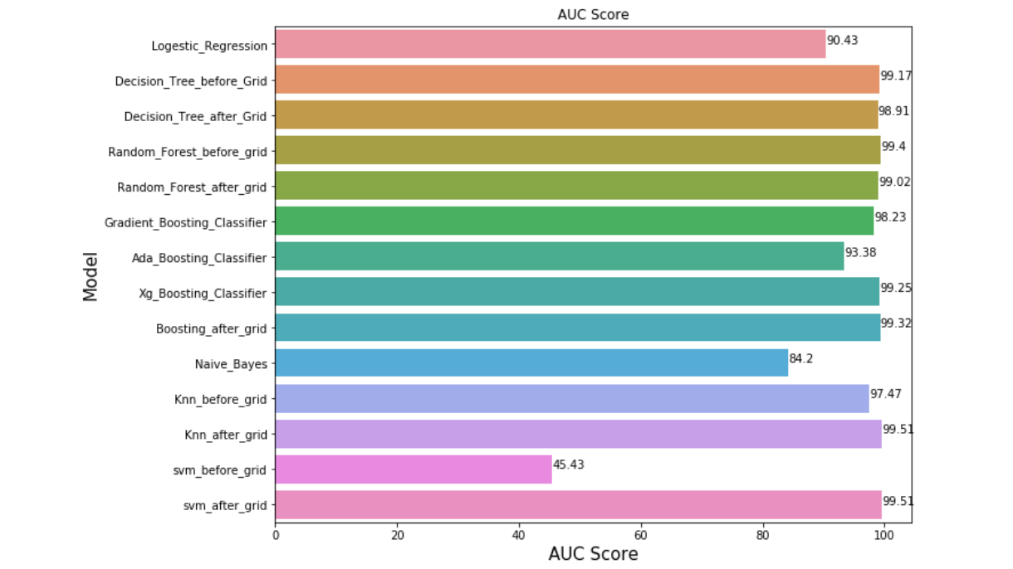
AUC score of the models

Slide 29
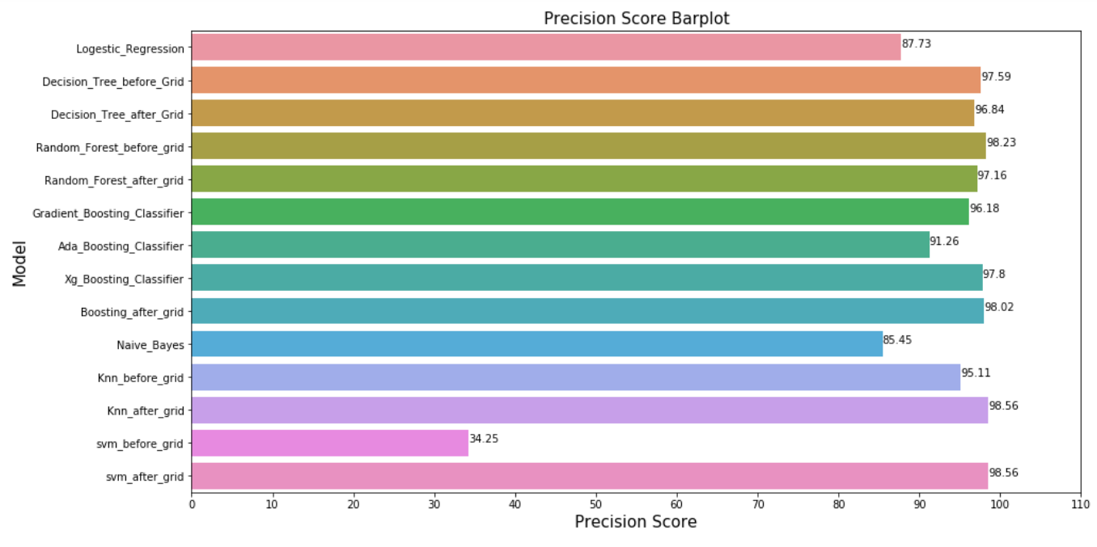
PRECISION Score of the models

Slide 30
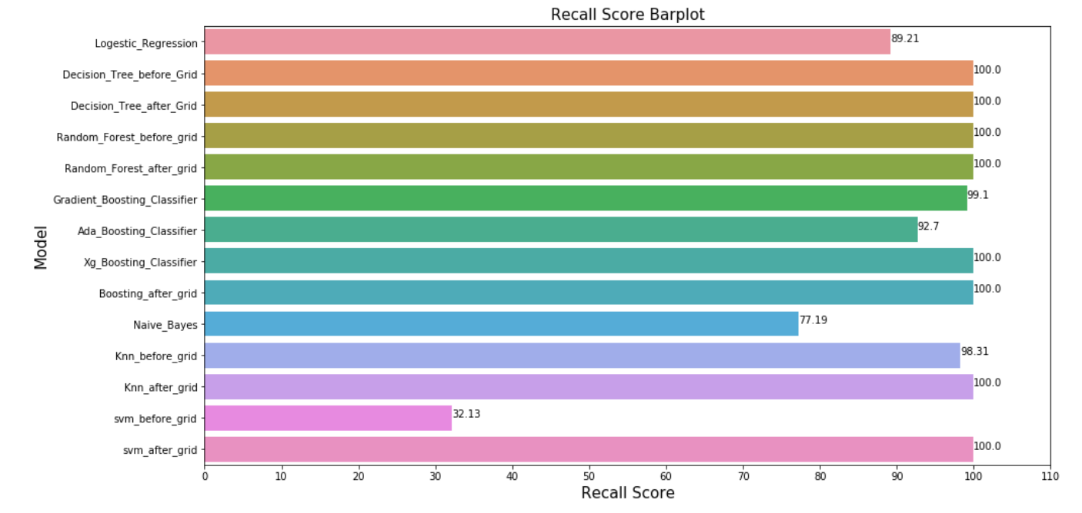
RECALL Score of the models

Slide 31
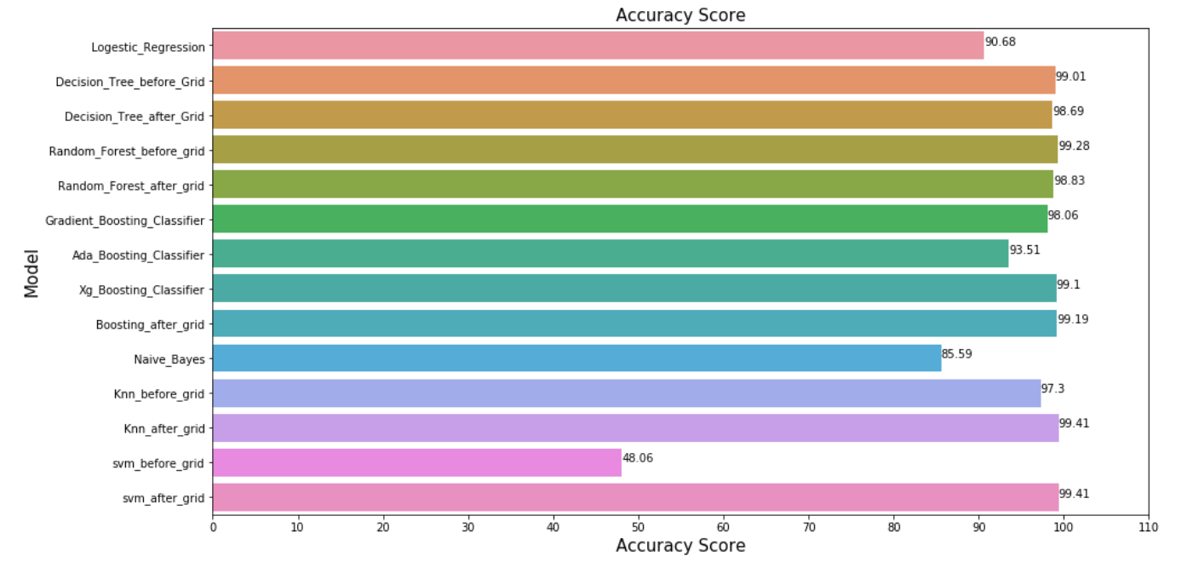
ACCURACY of the models

Slide 32
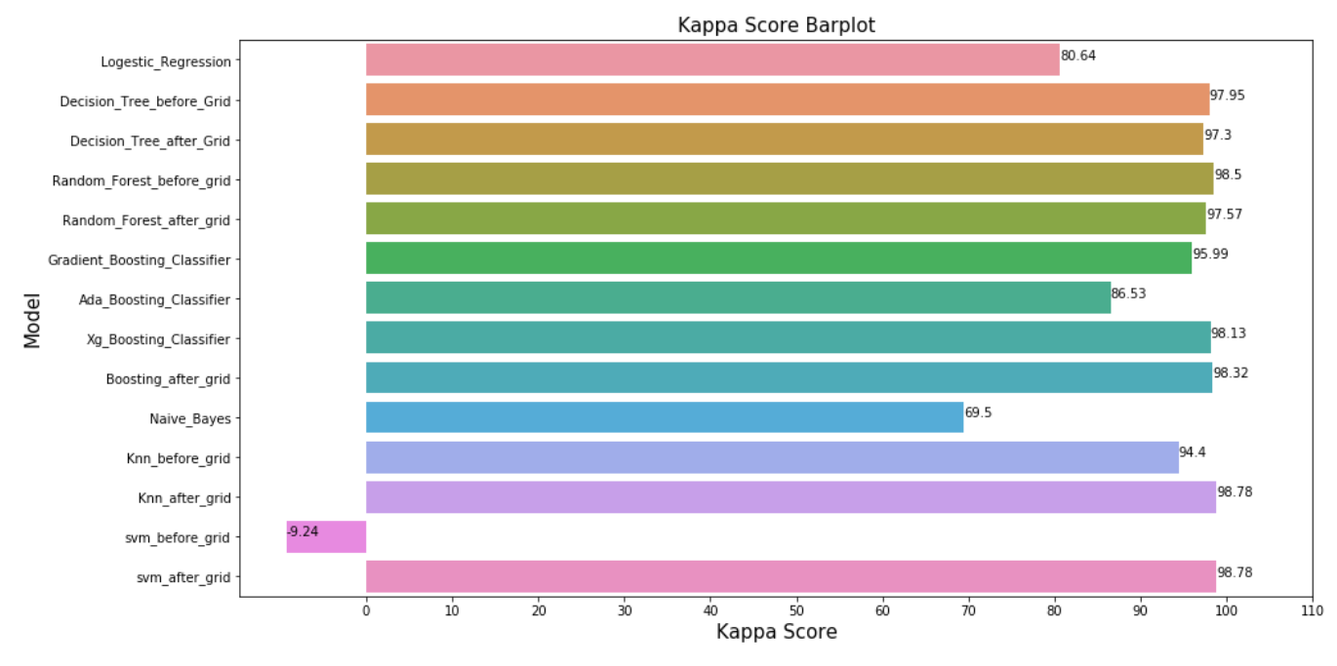
KAPPA Score of the models

Slide 33
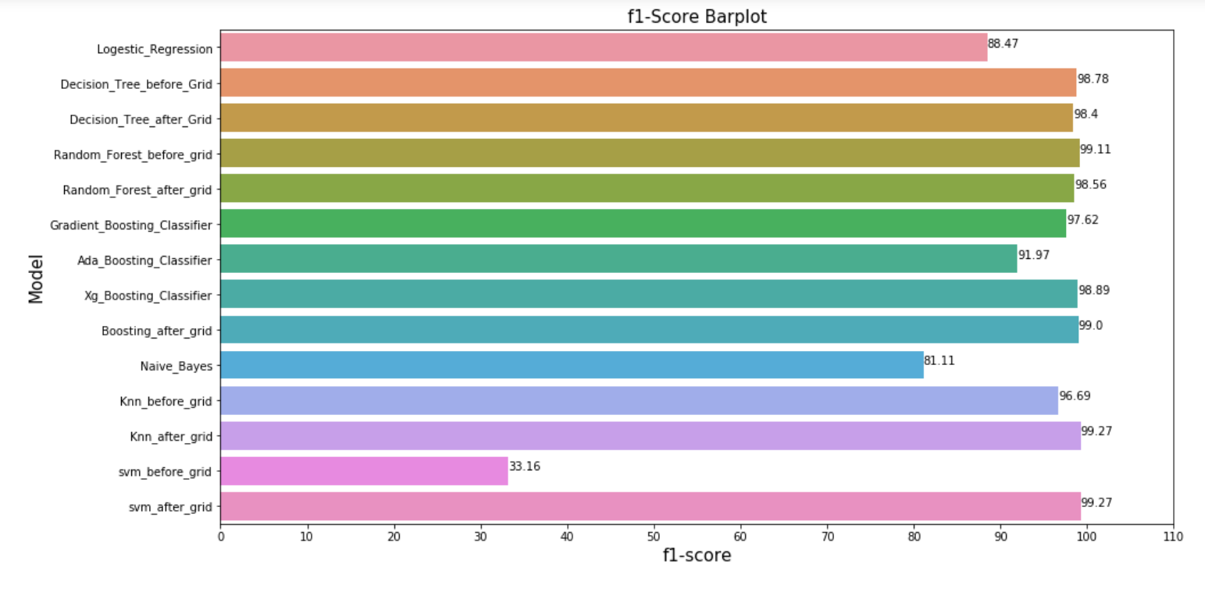
F1_SCORE of the models

Slide 34
RESULT
Most of the models are predicting the same results like Random Forest Classifier, Decision Tree classifier, Gradient Boosting Classifier, KNN classifier, Svm classifier(after grid) produces the accuracy of 98 to 99 percent
Logistic Regression ,SVM( before grid ) produces the less Accuracy comparing to the other models

Slide 35
KEY FINDING
CCAvg : Avg. spending on credit cards per month ($000),
Credit card : Does the customer use a credit card issued this two plays the major role in predicting the customer will get personal loan or not
ID(Customer ID),ZIP code is not so good for the predicting the customer will get personal loan or not

Slide 36
Helpful for Business
Age : Customer's age in completed years
Experience : #years of professional experience
Income : Annual income of the customer ($000)
Family : Family size of the customer
CCAvg : Avg. spending on credit cards per month ($000)
Education : Education Level. 1: Undergrad; 2: Graduate; 3: Advanced/Professional
Mortgage : Value of house mortgage if any. ($000)
CD Account : Does the customer have a certificate of deposit (CD) account with the bank?
Online : Does the customer use internet banking facilities?
Credit card : Does the customer use a credit card issued
By using this features we can predict the customer accept the personal loan

